Slide 1

Lorentzian Anomaly Attention (LAA):
A Self-Attentive Approach to Citation Networks
Adar Budomski 206539363
Shoval Ben Shushan 207502428
Supervisor: Dr.Dvora Toledano-Kitai
Project number: 25-2-R-1

Slide 2
Motivation & Project Need
Citation networks are dynamic and rapidly evolving
Citation patterns may exhibit early peaks, delayed impact, or sudden drops
Manual analysis is impractical due to scale and growth rate
Existing approaches are largely static and Euclidean-based
A suitable model must combine geometric structure and temporal information

Slide 3

Project Goal
Design and implement a system for anomaly detection in dynamic citation networks
Capture both structural hierarchy and temporal evolution of citation behavior
Evaluate the system using a controlled, label-free validation framework

Slide 4

Citation Networks
A citation network represents academic papers as nodes and citation links as edges.
As new papers and citations are added over time, the network evolves dynamically, in contrast to static networks that capture a fixed view.
Analyzing these evolving patterns helps reveal emerging research trends and unusual citation behaviors.

Slide 5
Anomaly Detection
Detecting Deviations
Evolving Citation Networks
Identifies patterns or behaviors that deviate from the norm.
Tracks how citation patterns change over time in dynamic networks.
Citation Anomalies
Scientific Impact
Detects sudden citation spikes, delayed growth, or unusual connections.
Reveals citation manipulation, breakthrough research, and emerging trends.

Slide 6
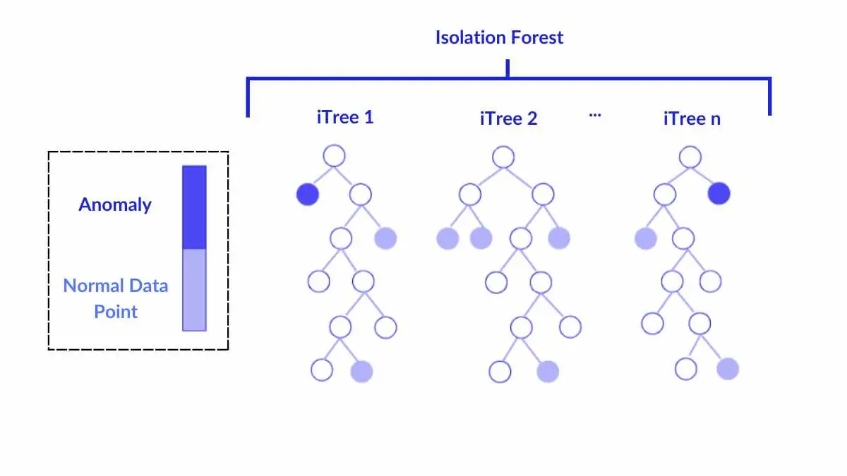
Isolation Forest (IF)
No Distribution Assumptions
Tree-Based Method
Reachability Distance
Efficient & Scalable

Slide 7
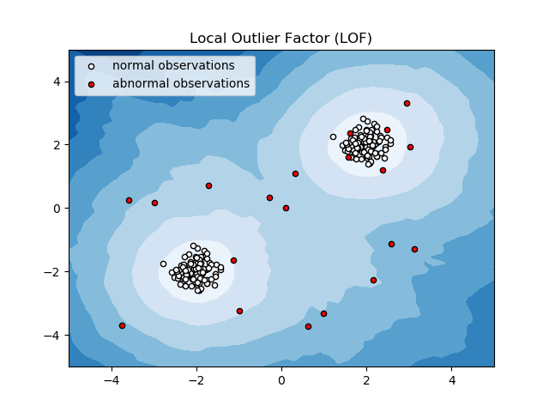
Local Outlier Factor (LOF)
Local Perspective
Density-Based Detection
Isolation Depth
Effective in Complex Data

Slide 8

Dataset
Academic citation dataset consisting of scientific papers and their citation relationships
Each paper includes: unique identifier, title, authors, publication year, field of study, textual abstract, and total citation count
Citation relationships are derived from reference lists between papers
Reflects the long-term evolution of scientific research

Slide 9
System Architecture
Stage 0:
Preprocessing
Prepare a dynamic representation of the network over time
Stage 1: Structural Representation Layer
Capture the hierarchical structure of the network at each time step
Stage 2:
Temporal Representation Layer
Model the temporal evolution of node representations across time
Stage 3: Anomaly Detection
Detect unusual citation patterns or behaviors based on the temporal dynamics of node representations

Slide 10
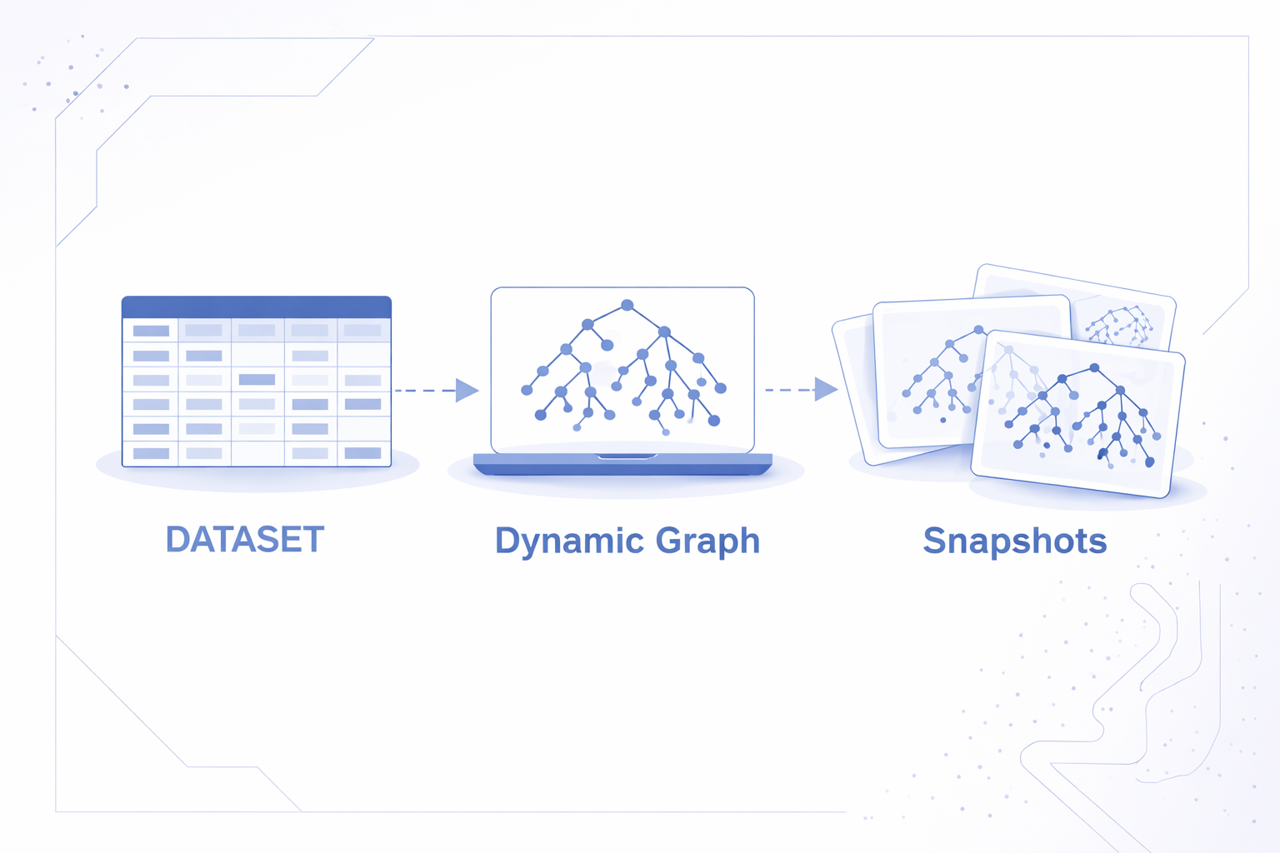
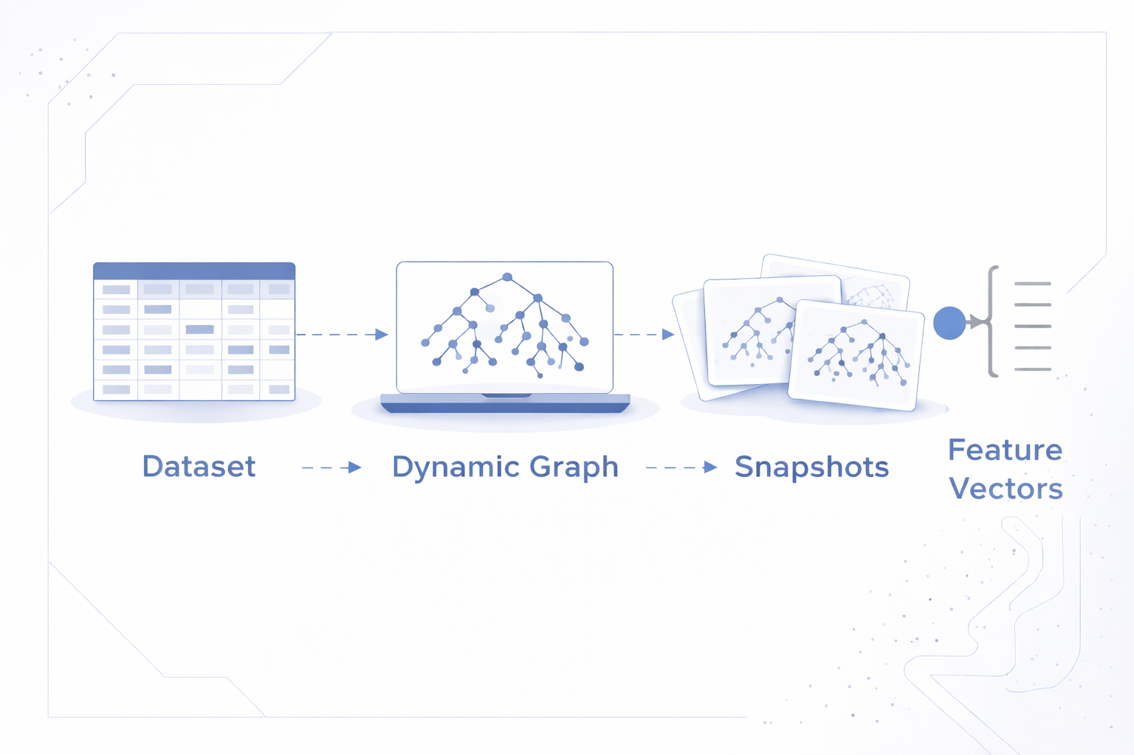
Stage 0: Preprocessing
The academic citation dataset is transformed into a directed graph, where papers are represented as nodes and citation as edges.
The publication year of each paper is used to split the citation graph into time-based snapshots.
For each snapshot and for each node, a feature vector is extracted and used as input to the next stage.

Slide 11
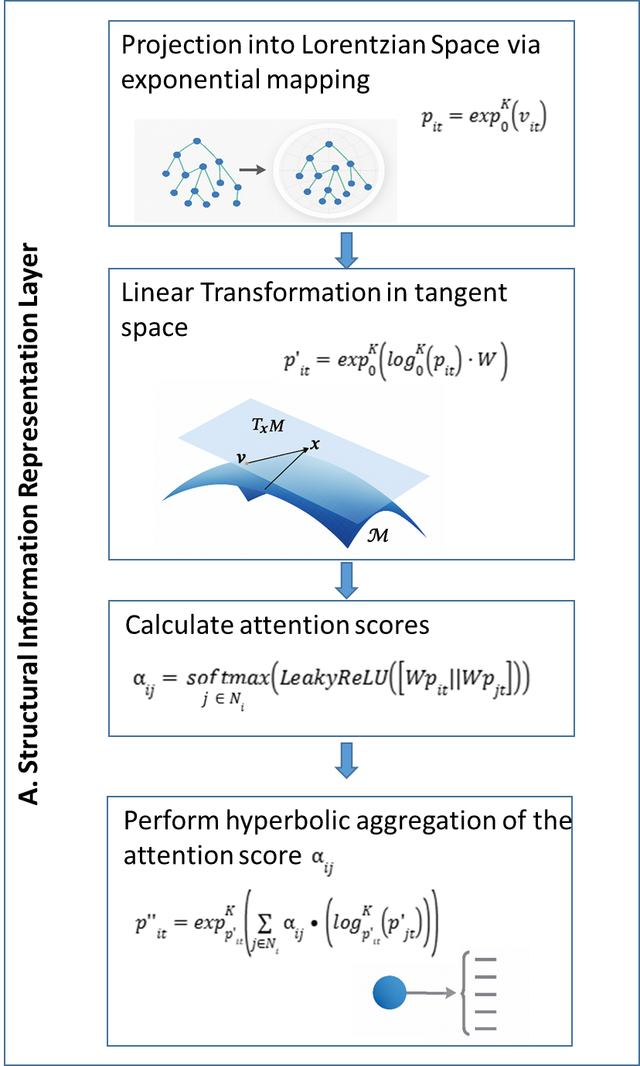
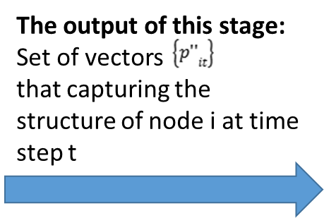

Stage 1:
Lorentzian Structural Representation

Slide 12
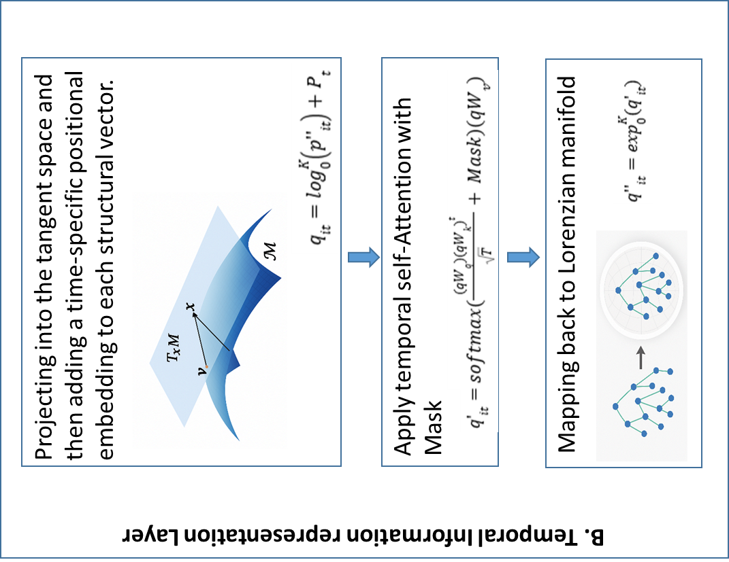
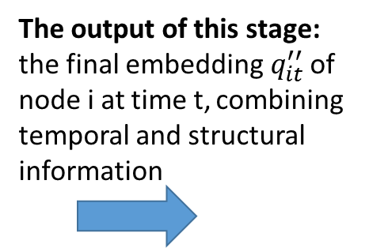
Stage 2:
Temporal Representation

Slide 13
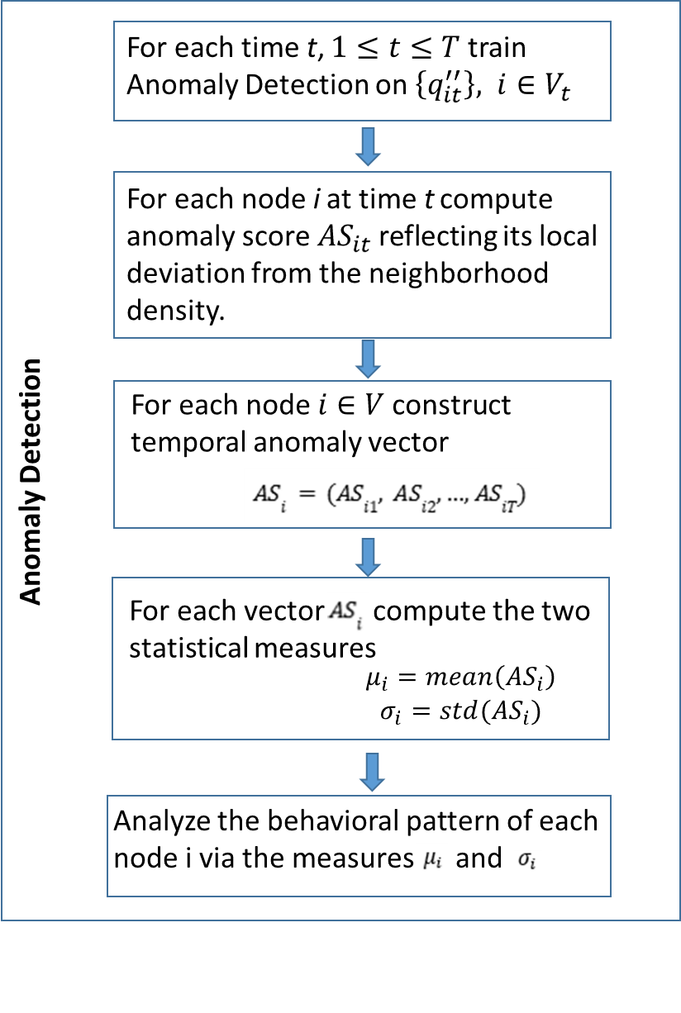
Stage 3:
Train Anomaly Detection

Slide 14
Validation Phase
Iterative Noise Injection:
Analyze Stability of Anomaly Scores for Real and Fake Nodes Across Iterations
Compute validation metrics (TPR, FPR)
Structural noise injection using fake nodes
Execute full pipeline with detection evaluation

Slide 15

Evaluation Metrics
TPR: Detection rate of injected synthetic anomalies
FPR: False alarms on real nodes
Evaluation of metrics across multiple validation iterations

Slide 16
Validation Parameters
Academic 10% synthetic nodes injected per iteration
Validation performed over 5 iterations
Parameters selected to balance metric stability (TPR/FPR) and computational efficiency
Ensures robustness evaluation under controlled and realistic perturbations

Slide 17
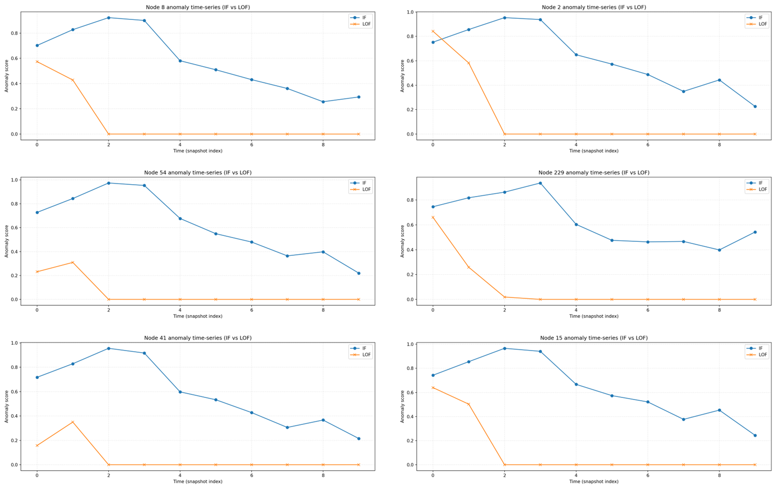
Results – Time Series Analysis
Fig.1 - Node-level anomaly score time-series (IF vs. LOF)

Slide 18
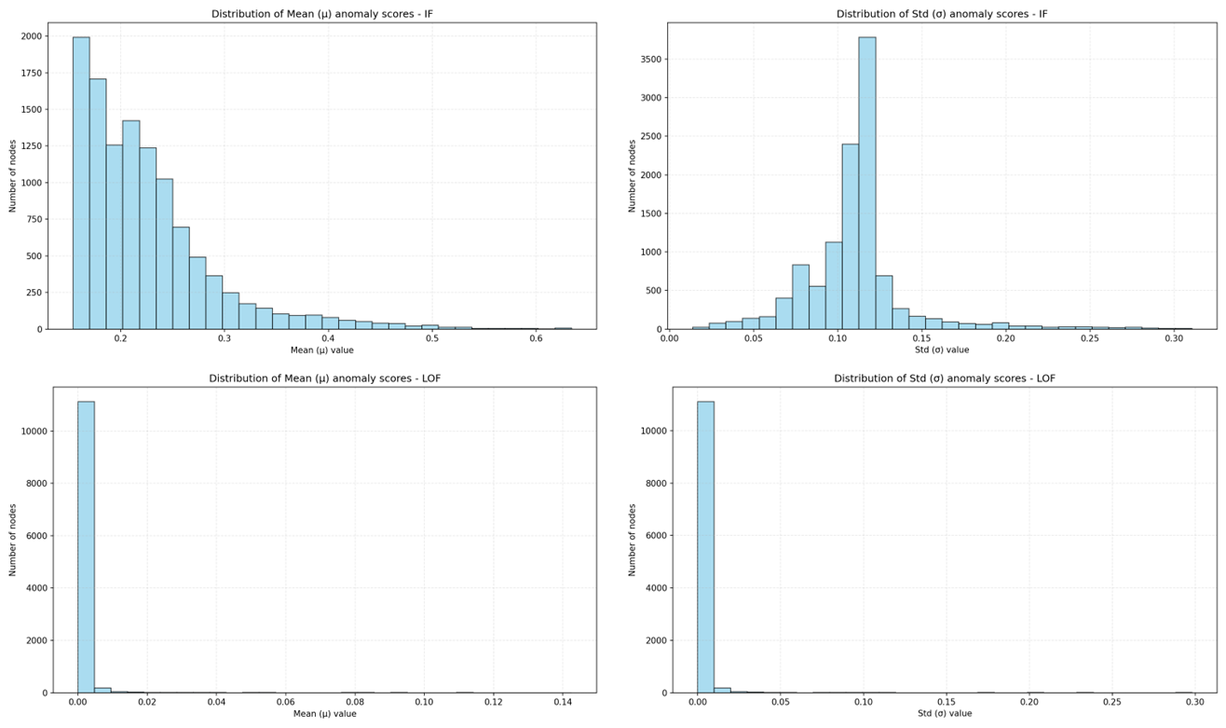
Results – Time Series Analysis
Fig.2 - Distribution of anomaly score mean and standard deviation for each method

Slide 19
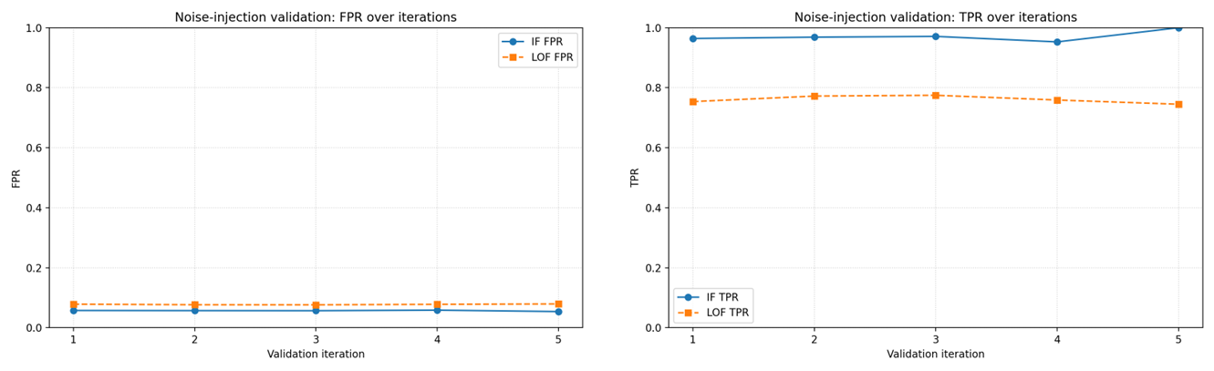
Results – Time Series Analysis
Fig.3 - Noise-injection validation results: TPR and FPR over iterations

Slide 20
Results – Distributions & Validation
Isolation Forest exhibits a stable and informative distribution of anomaly scores
LOF suffers from a collapse of the score distribution and a loss of discriminative capability
A clear performance gap is observed: Isolation Forest ≈ 98%, LOF ≈ 75%

Slide 21
Challenges
Key Challenges | Addressing the Challenges
Adapting research code | Architectural and code-level adaptations
Instability of LOF | Shift to Isolation Forest
Validation parameter tuning | Fixed noise ratio and iterations
Lack of ground truth labels | Synthetic noise injection

Slide 22
Key Contributions
Hyperbolic + temporal attention for citation anomalies
Label-free validation via noise injection
Empirical comparison IF vs LOF in dynamic setting

Slide 23
Conclusions
Matching detection methods to anomaly characteristics is critical in dynamic networks
Isolation Forest is better suited for global and temporal anomalies than LOF
Controlled validation with synthetic anomalies is essential when ground-truth labels are unavailable
Early and careful parameter selection leads to stable and comparable results
Adapting existing research code requires deep understanding of the model architecture

Slide 24
Thanks!
Do you have any questions?

